Slide 1



Slide 2
SER502-Spring2019-Team11
Team 11 – bumpy
Bharat Goel
Madhukar Raj
Palak Chugh
Yuti Desai

Slide 3
Feature Of The Language
Bumpy Language is developed in Prolog Completely
We are using Top- down parsing technique
Data structures used by the parser and interpreter: List
Interpreter: Our interpreter is based on Reduction machine.
It is an Imperative language and Statically typed
It provides data types such as Integer and Boolean
Looping construct – while loop
Decision control statement – if-else statement
inspired by C language

Slide 4
Operators and Constructs For BUMPY
Operators: +,-,*,/,%,<,>,<=,>=, ~=, :=:, = ,and, or,
Arithmetic Operator: +,-,*,/,%
Addition : +
Subtraction: -
Multiplication: *
Division: /
Mod: %
Comparison Operator: <,>,<=,>=, ~=, :=:
Less than: <
Greater than: >
Less than equal to: <=
Greater than equal to: >=
Not equals to: ~=
Equals to: :=:

Slide 5
Operators and Constructs For BUMPY
Assignment Operator: =
Boolean Operator : and, or ,not
Primitive types: bool, var
Bool : takes Boolean value
Var: takes integer value
Decision Constructs: incase do otherwise endcase
Incase (condition) do (process) otherwise (process) endcase
Iterative Constructs: when repeat endrepeat
When (condition) repeat (process) endrepeat

Slide 6
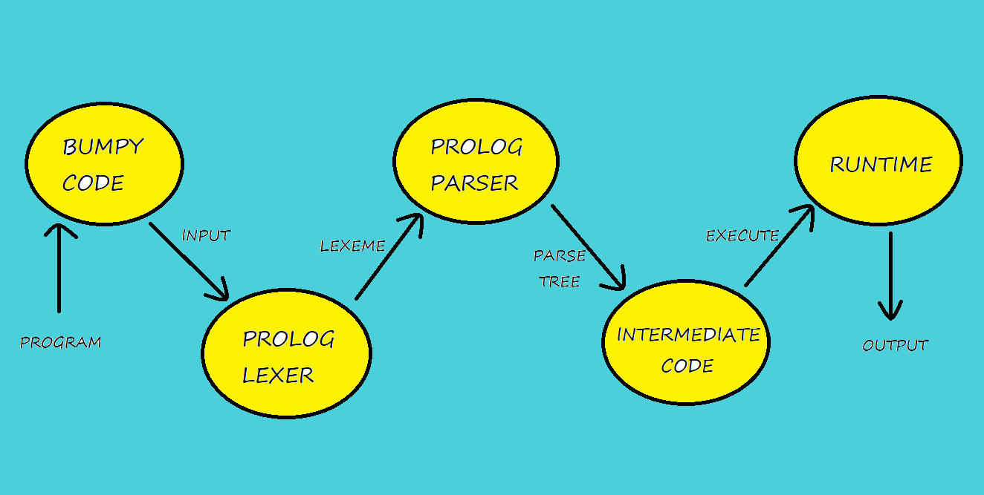

Design Flow

Slide 7
Lexical Analyzer and Parser
Lexical Analyzer and Parser written in Prolog Definite Clause Grammar.
Once the program is fed to the Lexer, it generates a list of lexemes for program by identifying keywords, eliminating spaces, tabs and new lines.
After getting the tokens, tokens are passed through the parser which is a prolog DCG code with the grammar defined for the language using prolog predicates and it generates the parse tree for the given code.
It Parses in a top-down fashion.

Slide 8
Intermediate Code
Parse tree is itself the intermediate code as we are using Prolog for creating language.
It gives Intermediate code as output to a separate file.
Intermediate Code is generated using DCG as well.
Used interpreter to evaluate the intermediate code.

Slide 9
Runtime/Interpreter
Programmed in Prolog.
The Interpreter is implemented by traversing node by node through the generated parse tree. Each node denotes an evaluation step that needs to be performed
The environment at each node is looked up or updated via a list data structure in prolog.
Used reduction rules to evaluate the code.

Slide 10
Language Grammar
Parser → Program
Program → Comment Block | Block
Comment → @ Words @
Block → start Declaration Process stop
Words → Identifier Words | Numb Words| Identifier| Numb.
Declaration → Datatype Identifier ; Declaration | Datatype Identifier ;
Process → Assignvalue ; Process | Control Process | Iterate Process | Print Process |ReadValue Process | Assignvalue ; | Control | Iterate | Print | ReadValue

Slide 11
Language Grammar (Continued..)
Datatype → var | bool
Assignvalue → Identifier = Expression| Identifier is Boolexp
Control → incase Condition do Process otherwise Process endcase
Iterate → when Condition repeat Process endrepeat
Print → show Expression ; | show * Value * ;
ReadValue → input Identifier ;
Condition → Boolexp and Boolexp| Boolexp or Boolexp | ~ Boolexp| Boolexp

Slide 12
Language Grammar (Continued..)
Boolexp → Expression :=: Expression |Expression ~= Expression| Expression <= Expression| Expression >= Expression|Expression < Expression| Expression > Expression |Expression :=: Boolexp|Expression ~= Boolexp| yes | no
Expression → Term + Expression |Term – Expression |Term
Term → Identifier * Term| Numb * Term|Numbneg * Term | Identifier / Term|Numb /Term|Numbneg /Term | Identifier mod Term|Numb mod Term|Numbneg mod Term|Identifier|Numb|Numbneg
Identifier → _[^a-z]alphanumeric | [^a-z]alphanumeric
Numb → number
Numbneg → - Numb

Slide 13
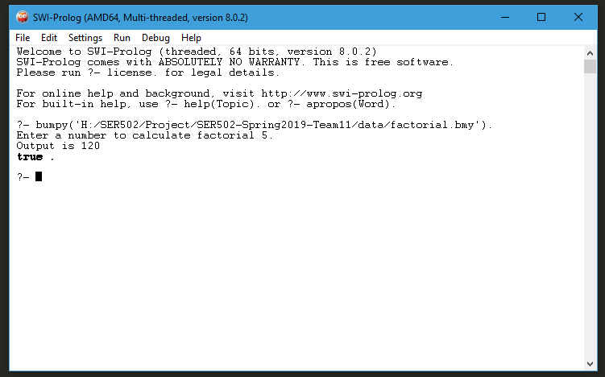
Demonstration: Executing Prolog Files

